Slide 1
Micro-architectural Attacks
Chester Rebeiro
IIT Madras

Slide 2

Things we thought gave us security!
Cryptography
Passwords
Information Flow Policies
Privileged Rings
ASLR
Virtual Machines and confinement
Javascript and HTML5 (due to restricted access to system resouces)
Enclaves (SGX and Trustzone)

Slide 3

Micro-Architectural Attacks (can break all of this)
Cryptography
Passwords
Information Flow Policies
Privileged Rings
ASLR
Virtual Machines and confinement
Javascript and HTML5 (due to restricted access to system resouces)
Enclaves (SGX and Trustzone)
Cache timing attack
Branch prediction attack
Speculation Attacks
Row hammer
Fault Injection Attacks
cold boot attacks
DRAM Row buffer (DRAMA)
….. and many more

Slide 4

Causes
Most micro-architectural attacks caused by performance optimizations
Others due to inherent device properties
Third, due to stronger attackers
security
performance

Slide 5
Cache Covert Channel
Chester Rebeiro
Indian Institute of Technology Madras

Slide 6
Cache Covert Channel
Processes
Processor
Cache
Memory
Memory

Slide 7
Cache Covert Channel
Processes
cache line
Processor
way
Cache
Memory
cache set
Memory

Slide 8
Cache Covert Channel
address
tag
set
line
cache line
chooses one set

Slide 9
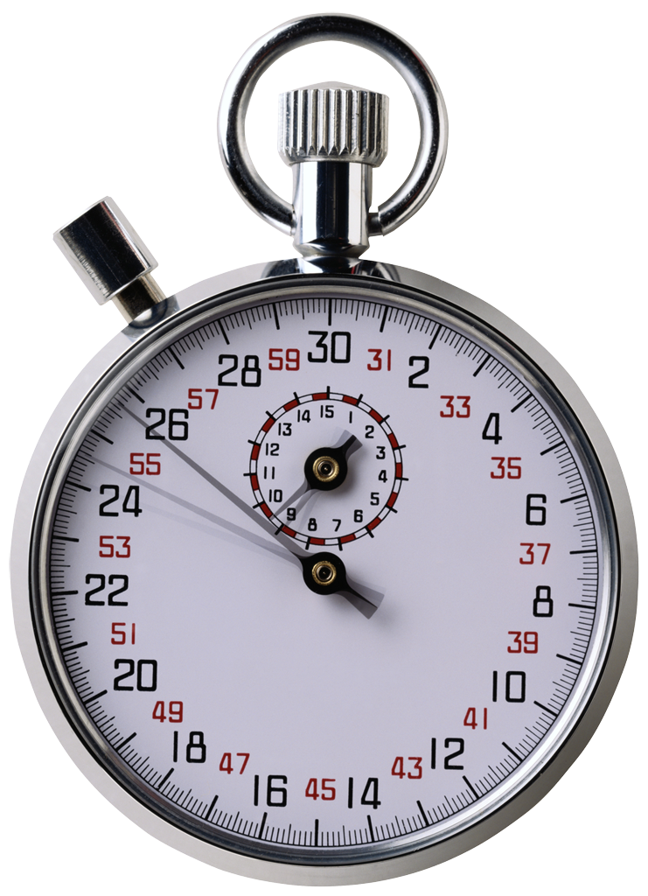
Cache Covert Channel
while(1){
load A1_{p2}; load A2_{p2}
load A3_{p2}; load A4_{p2}
load B1_{p2}; load B2_{p2}
load B3_{p2}; load B4_{p2}
}
Process P2
statistically
time A ~ time B
A Set
B Set

Slide 10
Cache Covert Channel
while(1){
load A1_{p2}; load A2_{p2}
load A3_{p2}; load A4_{p2}
load B1_{p2}; load B2_{p2}
load B3_{p2}; load B4_{p2}
}
Process P1
Process P2
statistically
time A > time B
If (bit == 1) load A_{P1}
Else
load B_{P1}
A Set
B Set

Slide 11
Cache Covert Channel
while(1){
load A1_{p2}; load A2_{p2}
load A3_{p2}; load A4_{p2}
load B1_{p2}; load B2_{p2}
load B3_{p2}; load B4_{p2}
}
Process P1
Process P2
statistically
time A < time B
If (bit == 1) load A_{P1}
Else
load B_{P1}
A Set
B Set

Slide 12
Cache Covert Channel
while(1){
load A1_{p2}; load A2_{p2}
load A3_{p2}; load A4_{p2}
load B1_{p2}; load B2_{p2}
load B3_{p2}; load B4_{p2}
}
Process P1
Process P2
statistically
time A < time B
bit = message
while(bit[i] != ‘\0’)
for(some number of iterations)
If (bit[i] == 1) load A_{P1}
else
load B_{P1}

Slide 13
Covert Channels
Identifying: Not easy because simple things like the existence of a file, time, etc. could be a source for a covert channel.
Quantification: communication rate (bps)
Elimination: Careful design, separation, characteristics of operation (eg. rate of opening / closing a file)

Slide 14
Flush+Reload Attacks
Chester Rebeiro
IIT Madras

Slide 15
Copy on Write
if (fork() > 0){
// in parent process
} else{
// in child process
}
Child created is an exact replica of the parent process.
Page tables of the parent duplicated in the child
New pages created only when parent (or child) modifies data
Postpone copying of pages as much as possible, thus optimizing performance
Thus, common code sections (like libraries) would be shared across processes.

Slide 16
Process Tree
init
Physical Memory
:
SSLEncryption()
:
:
SSLEncryption()
:
Virtual Memory
(process 2)
Virtual Memory
(process 1)

Slide 17
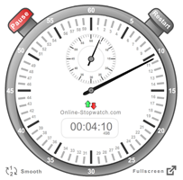
Interaction with the LLC
:
SSLEncryption()
:
Processes
Processes
Core 1
Core 2
cache misses
slow
LLC

Slide 18
Interaction with the LLC
:
SSLEncryption()
:
:
SSLEncryption()
:
Processes
Processes
Core 1
Core 2
cache hits
fast
LLC
One process can affect the execution time of another process

Slide 19
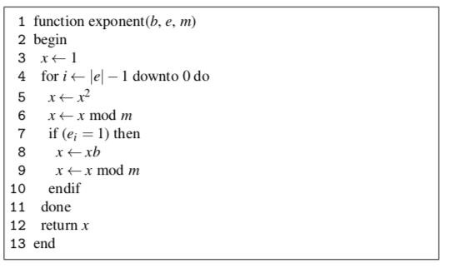
Flush + Reload Attack on LLC
Part of an encryption algorithm
clflush Instruction
Takes an address as input.
Flushes that address from all caches
clflush (line 8)
executed only when e_{i} = 1
Flush+Reload Attack, Yuval Yarom and Katrina Falkner (https://eprint.iacr.org/2013/448.pdf)

Slide 20
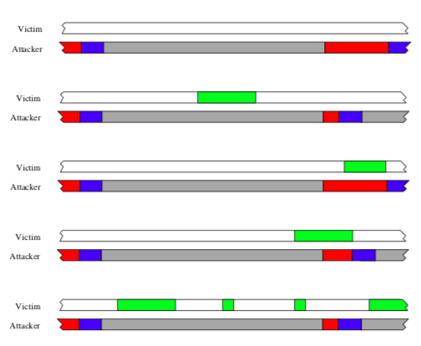
Flush + Reload Attack
:
SSLEncryption()
:
:
Clflush(line 8)
:
Processes
Processes
Core 1
Core 2
flush
attacker
reload
access
victim
LLC

Slide 21
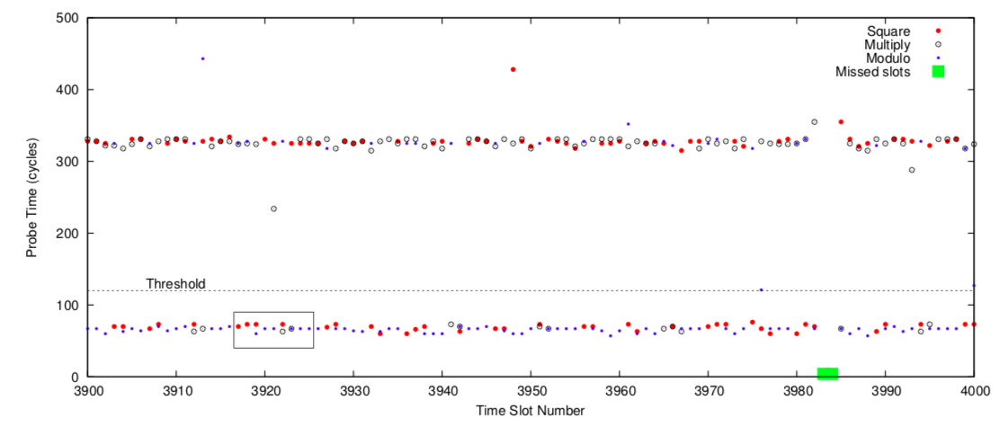
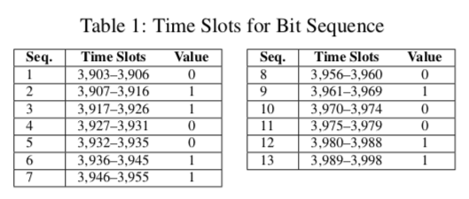
Flush+Reload Attack

Slide 22
Countermeasures
Do not use copy-on-write
Implemented by cloud providers
Permission checks for clflush
Do we need clflush?
Non-inclusive cache memories
AMD
Intel i9 versions
Fuzzing Clocks
Software Diversification
Permute location of objects in memory (statically and dynamically)

Slide 23
Cache Collision Attacks
Chester Rebeiro
IIT Madras

Slide 24
Cache Collision Attacks
External Collision Attacks
Prime + Probe
Internal Collision Attacks
Time-driven attacks

Slide 25


Prime + Probe Attack
Victim
Spy
Core 1
Core 2
Last Level Cache
Set 0
Set 1
Victim
Spy
Set 2
Set 3
SMT Core
Set N-2
L1 Cache Memory
Set N-1
way 0
way 1
way 2
way 3

Slide 26
Prime Phase
While(1){
for(each cache set){
start = time();
access all cache ways
end = time();
access_time = end – start
}
wait for some time
}
Set 0
Set 1
Set 2
Set 3
way 0
way 1
way 2
way 3

Slide 27
Victim Execution
The execution causes some of the spy data to get evicted
Set 0
Set 1
Set 2
Set 3
way 0
way 1
way 2
way 3

Slide 28

Probe Phase
While(1){
for(each cache set){
start = time();
access all cache ways
end = time();
access_time = end – start
}
wait for some time
}
Set 0
Set 1
Set 2
Set 3
Time taken by sets that have victim data is more due to the cache misses
way 0
way 1
way 2
way 3

Slide 29
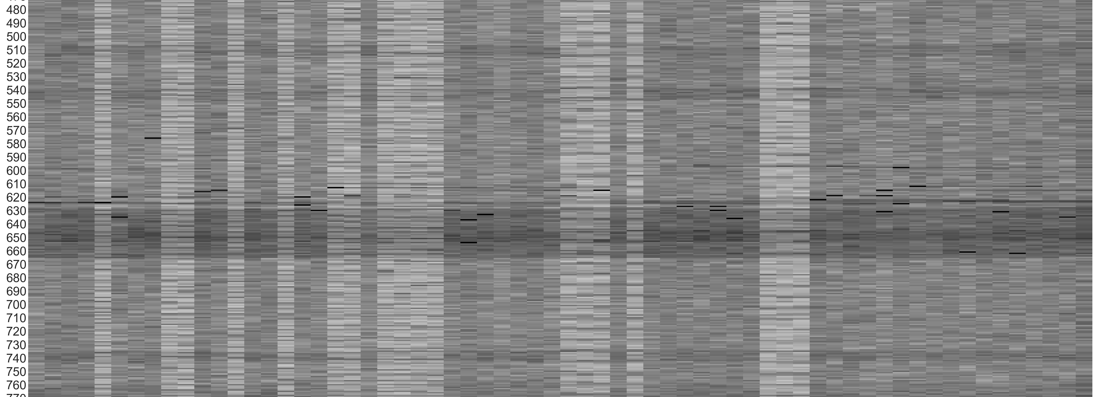
Probe Time Plot
0
63
Each row is an iteration of the while loop; darker shades imply higher memory access time

Slide 30
Prime + Probe in Cryptography
char Lookup[] = {x, x, x, . . . x};
char RecvDecrypt(socket){
char key = 0x12;
char pt, ct;
read(socket, &ct, 1);
pt = Lookup[key ^ ct];
return pt;
}
Key dependent memory accesses
The attacker know the address of Lookup and the ciphertext (ct)
The memory accessed in Lookup depends on the value of key
Given the set number, one can identify bits of key ^ ct.

Slide 31
Keystroke Sniffing
Keystroke → interrupt → kernel mode switch → ISR execution → add to keyboard buffer → … → return from interrupt
Set 0
Set 1
Set 2
Set 3
way 0
way 1
way 2
way 3

Slide 32
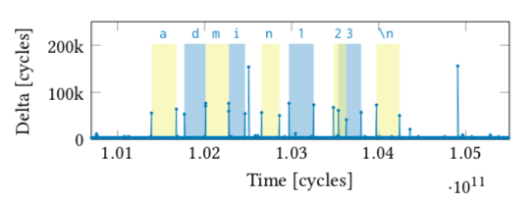
Keystroke Sniffing
Regular disturbance seen in Probe Time Plot
Period between disturbance used to predict passwords
Svetlana Pinet, Johannes C. Ziegler, and F.-Xavier Alario. 2016. Typing Is Writing: Linguistic Properties Modulate Typing Execution. Psychon Bull Rev 23, 6

Slide 33
Web Browser Attacks
Prime+Probe in
Javascript
pNACL
Web assembly

Slide 34
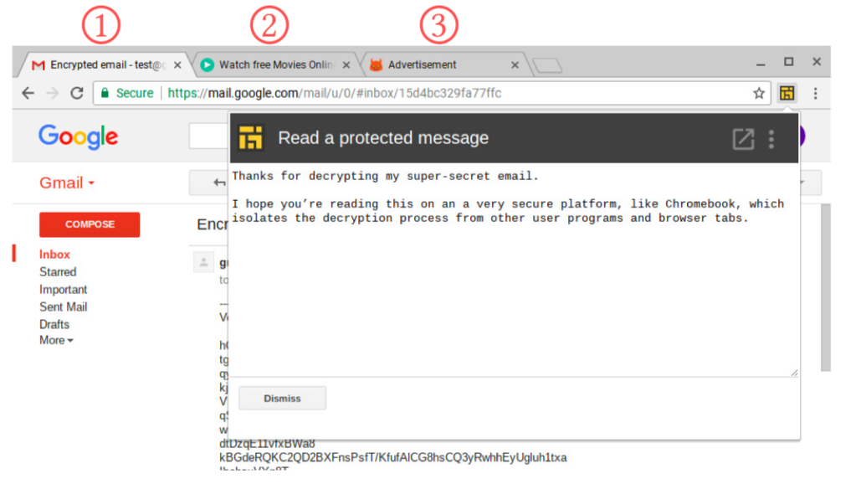
Extract Gmail secret key
https://www.cs.tau.ac.il/~tromer/drivebycache/drivebycache.pdf

Slide 35
Website Fingerprinting
Privacy: Find out what websites are being browsed.

Slide 36
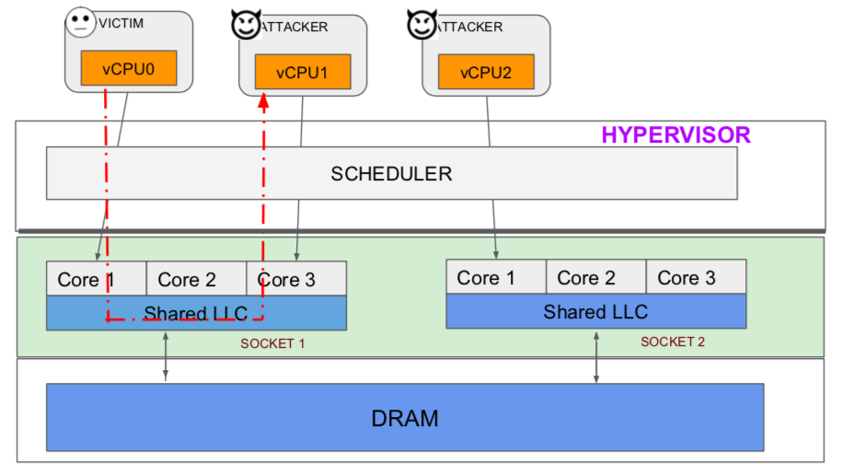
Cross VM Attacks (Cache)

Slide 37
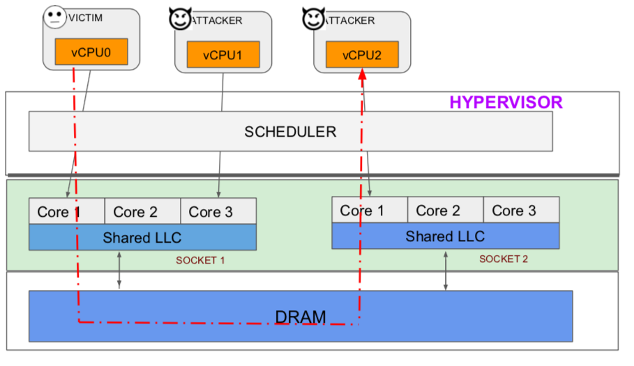
Cross VM Attacks (DRAM)

Slide 38
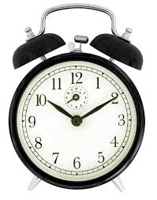
Internal Collision Attacks
Victim
(Adversary)

Slide 39
Internal Collisions on a Cipher
Part of a Cipher
Table
Table
(Adversary)
P₀
,P₄
If cache hit (less time) :
If cache miss (more time):
39

Slide 40

P₀
P₄
Random
Suppose
(K₀ = 00 and k₄ = 50)
P4 | Average Time | DOM
00 | 2945.3 | 1.8
10 | 2944.4 | 0.9
20 | 2943.7 | 0.2
30 | 2943.7 | 0.2
40 | 2944.8 | 1.3
50 | 2937.4 | -6.3
60 | 2943.3 | -0.2
70 | 2945.8 | 2.3
: | : | :
F0 | 2941.8 | -1.7
P₀ = 0, all other inputs are random
Make N time measurements
Segregate into Y buckets based on value of P₄
Find average time of each bucket
Find deviation of each average from overall average (DOM)
Block Cipher
Cipher Text
P₀
P₄
K₀
K₄
T
T
Average : 2943.57
Maximum : -6.3

Slide 41
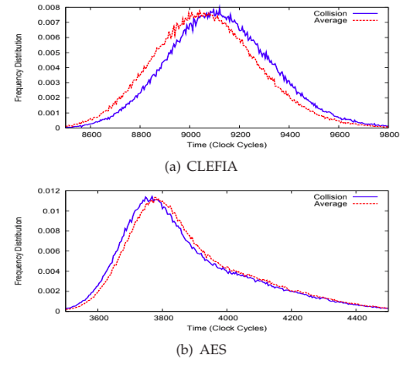
Implementation | Difference of Means
AES (OpenSSL 0.9.8a ) | -6.5
DES (PolarSSL 1.1.1 ) | +11
CAMELLIA (PolarSSL 1.1.1) | 19.2
CLEFIA (Ref. Implementation 1.0) | 23.4
Easiness to attack

Slide 42
Speculation Attacks
Some of the slides motivated from Yuval Yarom’s talk on Meltdown and Spectre at the Cyber security research bootcamp 2018

Slide 43
Out-of-order execution
How instructions are
fetched
How they may be
executed
How the results are
committed
load r0, addr1
mov r2, r1
add r2, r2, r3
store r1, add2
sub r4, r5, r6
sub r4, r5, r6
store r1, add2
mov r2, r1
add r2, r2, r3
load r0, addr1
r0
r2
r2
addr2
r4
inorder
out-of-order
order restored
Out the processor core, execution looks in-order
Insider the processor core, execution is done out-of-order

Slide 44
Speculative Execution
cmp r0, r1
jnz label
load r0, addr1
mov r2, r1
add r2, r2, r3
store r1, add2
sub r4, r5, r6
:
:
:
label:
more instructions
r0
r2
r2
add2
r4
:
:
:
cmp r0, r1
jnz label
load r0, addr1
mov r2, r1
add r2, r2, r3
store r1, add2
sub r4, r5, r6
:
:
:
label:
more instructions
How instructions are
fetched
How instructions are
executed
How results are committed when speculation is correct
Speculative execution
(transient instructions)

Slide 45
Speculative Execution
cmp r0, r1
jnz label
load r0, addr1
mov r2, r1
add r2, r2, r3
store r1, add2
sub r4, r5, r6
:
:
:
label:
more instructions
:
:
:
cmp r0, r1
jnz label
load r0, addr1
mov r2, r1
add r2, r2, r3
store r1, add2
sub r4, r5, r6
:
:
:
label:
more instructions
Speculated results
discarded
How instructions are
fetched
How instructions are
executed
How results are committed when speculation is incorrect
Speculative execution
(transient instructions)

Slide 46
Speculative Execution
cmp r0, r1
div r0, r1
load r0, addr1
mov r2, r1
add r2, r2, r3
store r1, add2
sub r4, r5, r6
:
:
:
label:
more instructions
:
:
:
cmp r0, r1
div r0, r1
load r0, addr1
mov r2, r1
add r2, r2, r3
store r1, add2
sub r4, r5, r6
:
:
:
label:
more instructions
Speculated results
discarded
How instructions are
fetched
How instructions are
executed
How results are committed when speculation is incorrect
(eg. If r1 = 0)
Speculative execution

Slide 47
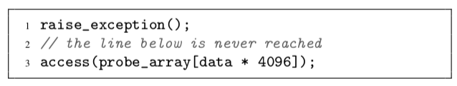
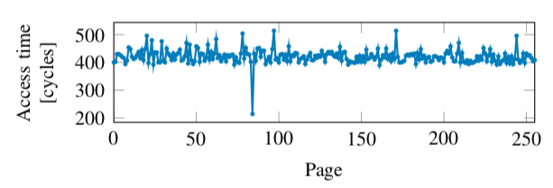
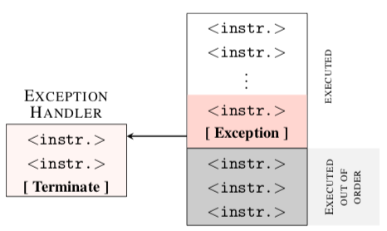
Speculative Execution and Micro-architectural State
data=84
Even though line 3 is not reached, the micro-architectural state is modified due
to Line 3.

Slide 48
Meltdown
Virtual address space of process
Normal Circumstances
i = *pointer y = array[i * 256]
Kernel space
Cache Memory
Set 0
Set 1
*pointer
Set 2
Set 3
User space
array
way 0
way 1
way 2
way 3

Slide 49
Meltdown
Virtual address space of process
Not normal Circumstances
i = *pointer y = array[i * 256]
Kernel space
*pointer
Cache Memory
Set 0
Set 1
Set 2
Set 3
User space
array
way 0
way 1
way 2
way 3

Slide 50
Meltdown
Virtual address space of process
Not normal Circumstances
i = *pointer y = array[i * 256]
Kernel space
*pointer
Cache Memory
Set 0
Set 1
Set 2
Set 3
User space
array
cache miss
way 0
way 1
way 2
way 3

Slide 51
Meltdown
Virtual address space of process
Not normal Circumstances
i = *pointer y = array[i * 256]
Kernel space
*pointer
Cache Memory
Set 0
Set 1
Set 2
Set 3
User space
array
cache miss
way 0
way 1
way 2
way 3

Slide 52
Meltdown
Virtual address space of process
Not normal Circumstances
i = *pointer y = array[i * 256]
Kernel space
*pointer
Cache Memory
Set 0
Set 1
Set 2
Set 3
User space
array
cache miss
way 0
way 1
way 2
way 3

Slide 53
Meltdown
Virtual address space of process
Not normal Circumstances
i = *pointer y = array[i * 256]
Kernel space
*pointer
Cache Memory
Set 0
Set 1
Set 2
Set 3
User space
array
cache hit
way 0
way 1
way 2
way 3

Slide 54
Spectre
Slides motivated from Yuval Yarom’s talk on Meltdown and Spectre at the Cyber security research bootcamp 2018

Slide 55
Spectre (variant 1)
user space of a process
array_len
Cache memory
if (x < array_len){
i = array[x];
y = array2[i * 256];
}
secret
array
x
array2

Slide 56
Spectre (variant 1)
user space of a process
array_len
Cache memory
if (x < array_len){
i = array[x];
y = array2[i * 256];
}
secret
<
array
x
array2

Slide 57
Spectre (variant 1)
user space of a process
array_len
Normal Behavior
Cache memory
if (x < array_len){
i = array[x];
y = array2[i * 256];
}
secret
array
x
array2

Slide 58
Spectre (variant 1)
user space of a process
array_len
Normal Behavior
Cache memory
if (x < array_len){
i = array[x];
y = array2[i * 256];
}
secret
array
x
array2
x 256

Slide 59
Spectre (variant 1)
user space of a process
array_len
Normal Behavior
Cache memory
if (x < array_len){
i = array[x];
y = array2[i * 256];
}
secret
array
x
array2
x 256

Slide 60
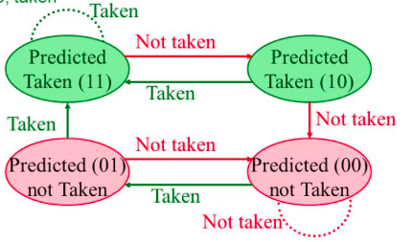
Spectre (variant 1)
user space of a process
array_len
Normal Behavior
Cache memory
if (x < array_len){
i = array[x];
y = array2[i * 256];
}
secret
array
x
array2
x 256

Slide 61
Spectre (variant 1)
user space of a process
array_len
Under Attack
Cache memory
if (x < array_len){
i = array[x];
y = array2[i * 256];
}
secret
array
x > array_len
array_len not in cache
secret in cache memory
x
array2

Slide 62
Spectre (variant 1)
user space of a process
array_len
if (x < array_len){
i = array[x];
y = array2[i * 256];
}
secret
array
<
Misprediction!
x
array2

Slide 63
Spectre (variant 1)
user space of a process
array_len
if (x < array_len){
i = array[x];
y = array2[i * 256];
}
secret
array
<
Misprediction!
x
array2

Slide 64
Spectre (variant 1)
user space of a process
array_len
if (x < array_len){
i = array[x];
y = array2[i * 256];
}
secret
array
x
array2
Cache hit found only here

Slide 65
Spectre (variant 2)
Attacker’s
address space
Victim’s
address space
Some gadget
ret
Jmp *eax
Jmp *ebx

Slide 66
Spectre (variant 2)
Attacker’s
address space
Victim’s
address space
context
switch
Some gadget
ret
Jmp *eax
Jmp *ebx

Slide 67
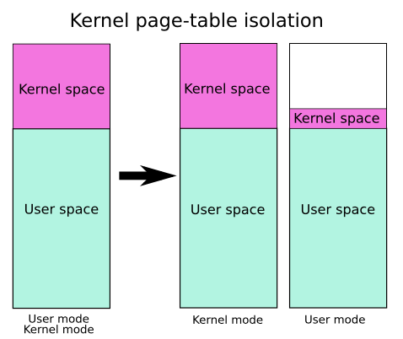
Countermeasures
For meltdown: kpti (kernel page table isolation)

Slide 68
Countermeasures
For Spectre (variant 1): compiler patches
use barriers (LFENCE instruction) to prevent speculation
static analysis to identify locations where attackers can control
speculation

Slide 69
Countermeasures
For Spectre (Variant 2): Separate BTBs for each process
Prevent BTBs across SMT threads
Prevent user code does not learn from lower security execution

Slide 70
Countermeasures
For all: at hardware
Every speculative load and store should bypass cache and stored in a special buffer known as speculative buffer

